Slide 1
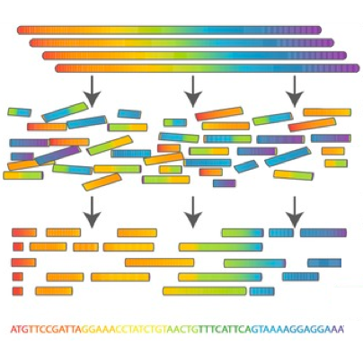

Scientific Computing for Biologists

Slide 2
Scientific Computing for Biologists
5-10 minutes for class discussion and dialog over previous lesson(s)…
Questions about previous lecture(s)?
Discussion of Final Project progress?
General Questions about scientific computing?

Slide 3
Scientific Computing for Biologists
Why learn the command line?
It’s the foundation for most of bioinformatics
Enables use of non-GUI (Graphical User Interface) tools
Can quickly perform operations on large files
Reproducibility
Automation of repetitive tasks
Enables use of higher-powered computers elsewhere (server/cloud)

Slide 4
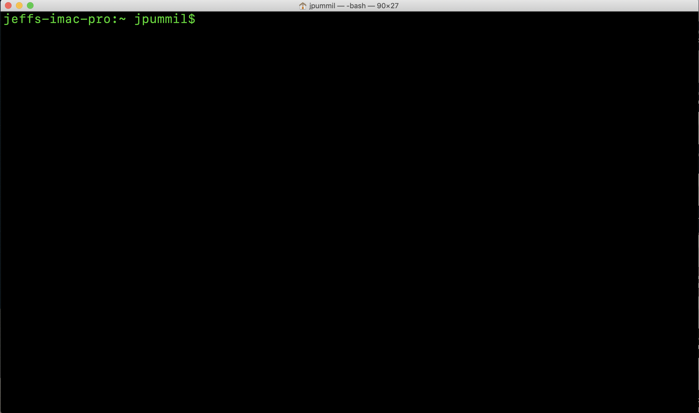
Scientific Computing for Biologists

Slide 5
Scientific Computing for Biologists
A few basic tips before we begin:
Linux/Unix is case sensitive – TEST, Test, and test are all DIFFERENT
Avoid spaces in filenames – test one (bad). test-one or test_one (good)
DO NOT use Windows to create text files you will use on Linux.
Windows adds hidden characters that won’t work on Linux.
DO assign suffixes to file names. Ex: test should be test.txt or test.dat
Linux doesn’t care…but humans need it to keep track.

Slide 6
Scientific Computing for Biologists
A recap of what we learned last time:
Tab Key – filename completion
Arrow Up Key – scroll thru previous commands
* and ? – Wild card characters
more and less – file perusal filters
wc – word count
| and > – file pipes and redirects
head and tail – output first or last part of file
BONUS COMMAND: clear – clears the messy text in the terminal
BONUS COMMAND: history – log of previous commands executed
BONUS COMMAND: Tab and Arrow-Up – short cut keys

Slide 7
Scientific Computing for Biologists
So, let’s get right to it! Some new basic commands to incorporate:
cat – concatenate files to standard output
cut – remove sections from each line of files
sort – sort lines of text files
diff – compare files line by line
uniq – report or omit repeated lines
BONUS COMMAND: clear – clears the messy text in the terminal
BONUS COMMAND: history – log of previous commands executed
BONUS COMMAND: Tab and Arrow-Up – short cut keys
BONUS COMMAND: Man <command> - help file for linux commands

Slide 8
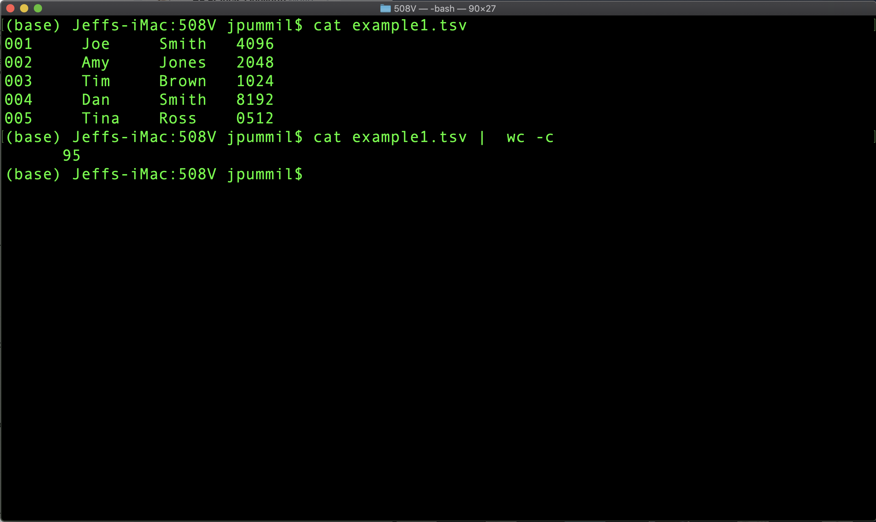
Scientific Computing for Biologists

Slide 9
Scientific Computing for Biologists
So, let’s get right to it! Some new basic commands to incorporate:
cat – concatenate files to standard output
cut – remove sections from each line of files
sort – sort lines of text files
diff – compare files line by line
uniq – report or omit repeated lines
BONUS COMMAND: clear – clears the messy text in the terminal
BONUS COMMAND: history – log of previous commands executed
BONUS COMMAND: Tab and Arrow-Up – short cut keys
BONUS COMMAND: Man <command> - help file for linux commands

Slide 10
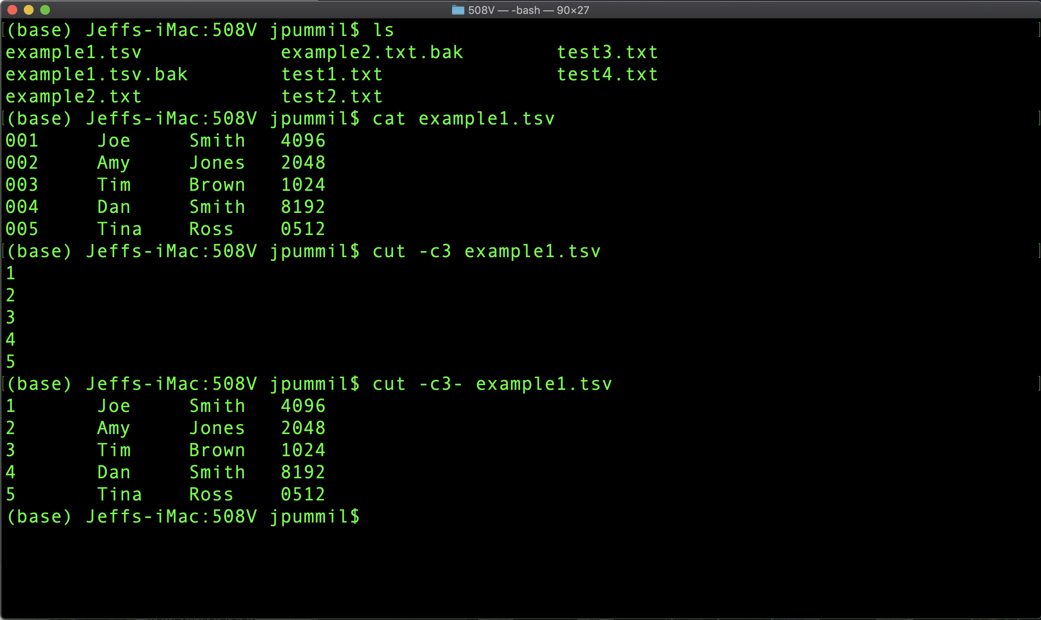
Scientific Computing for Biologists

Slide 11
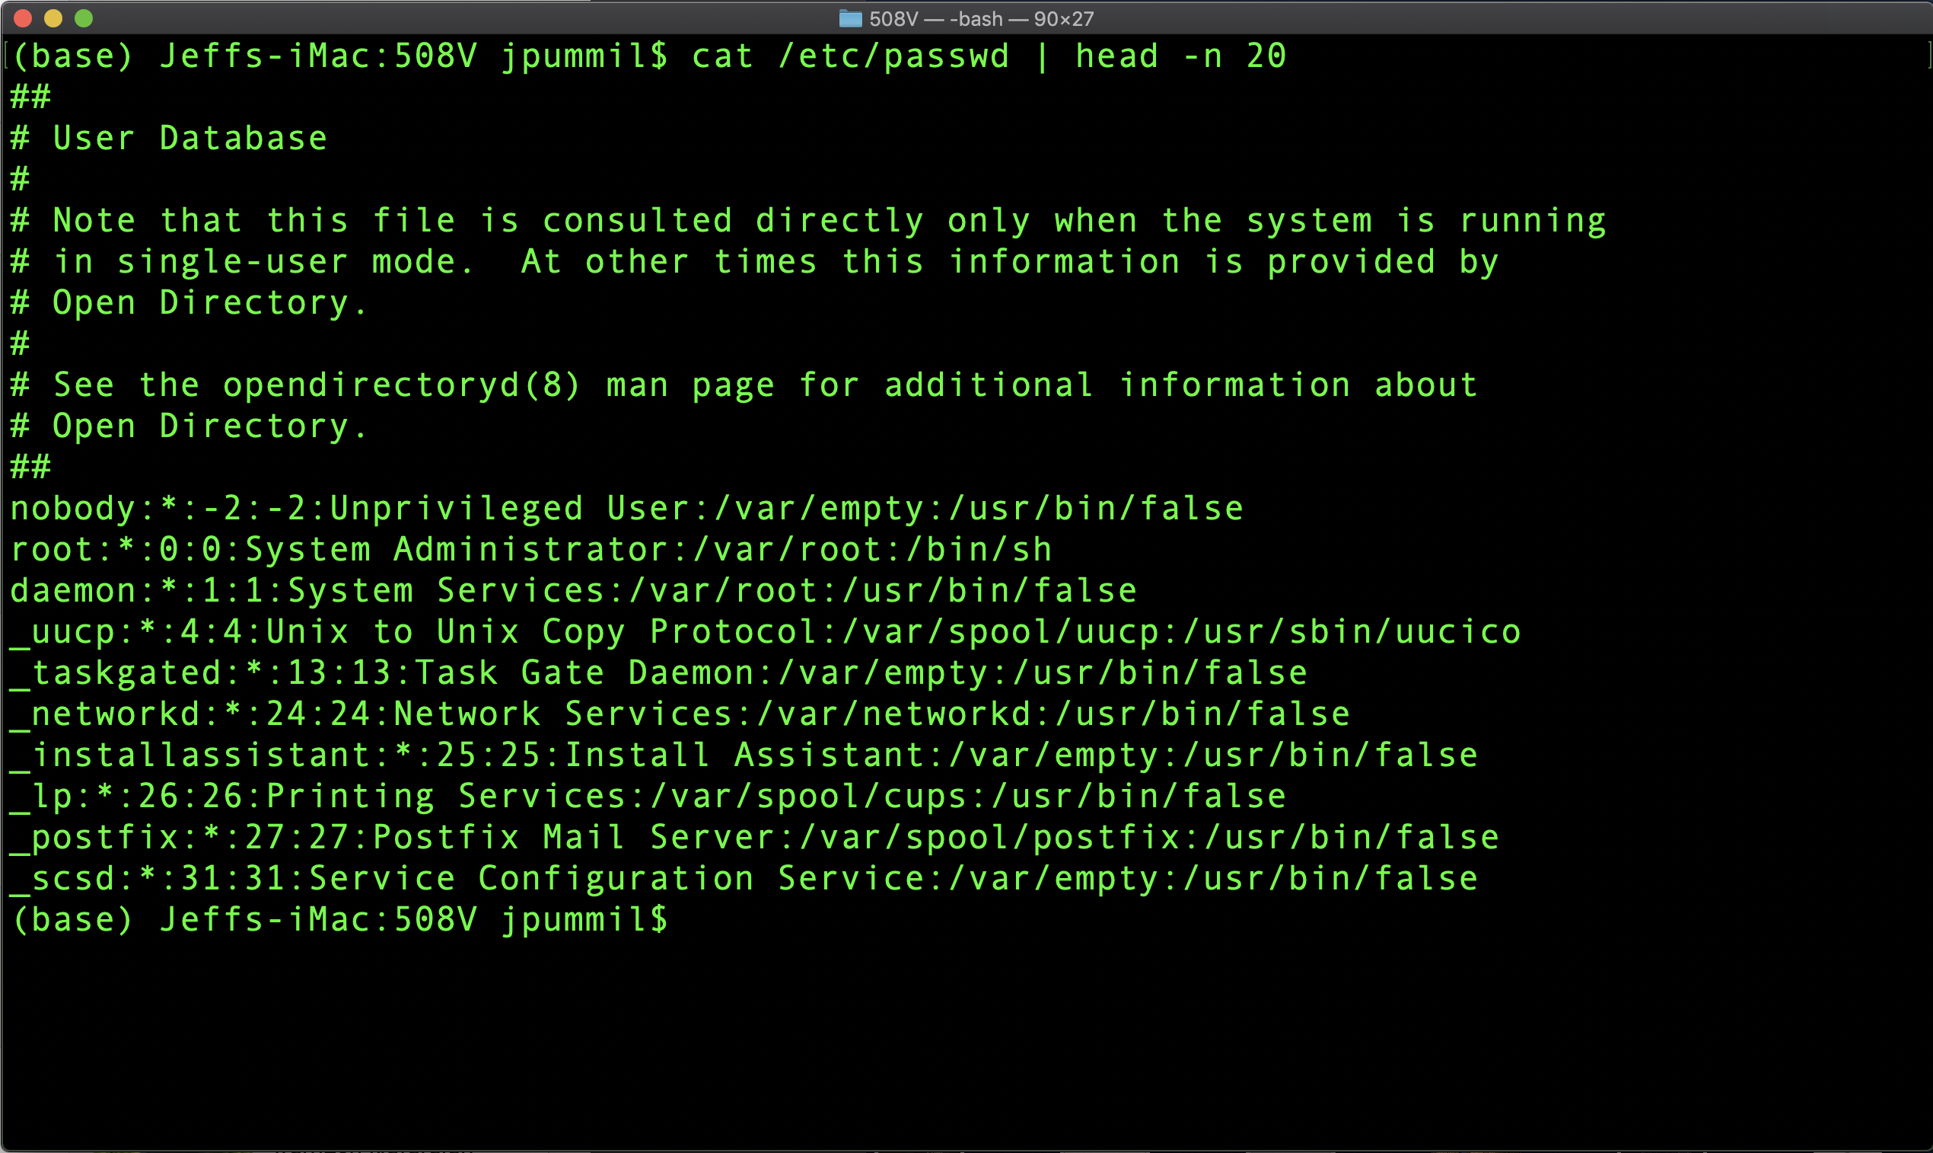
Scientific Computing for Biologists

Slide 12
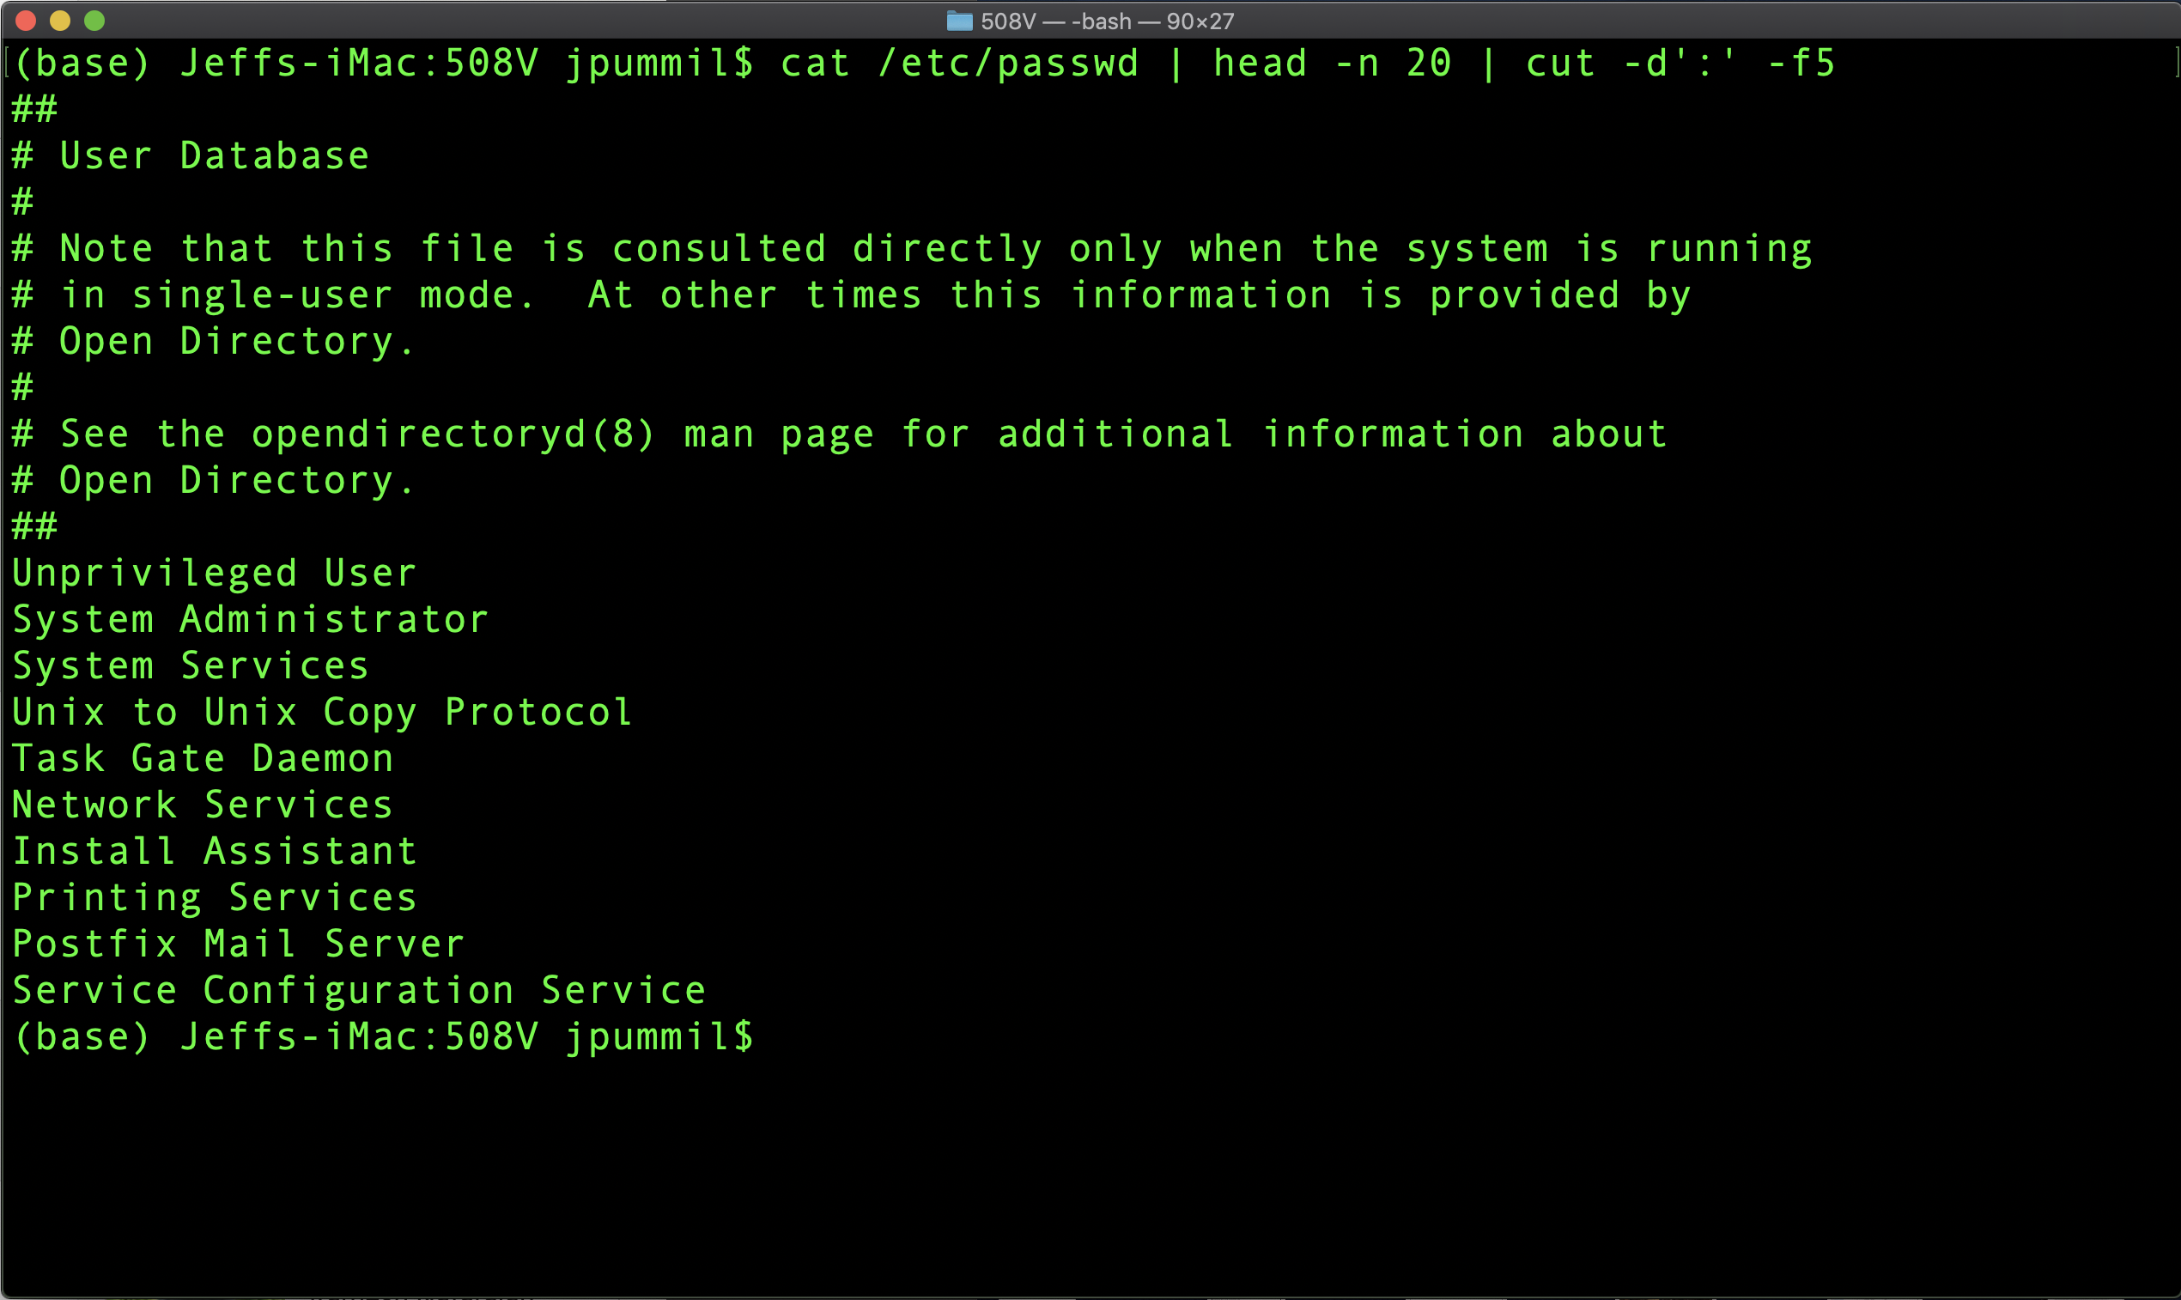
Scientific Computing for Biologists

Slide 13
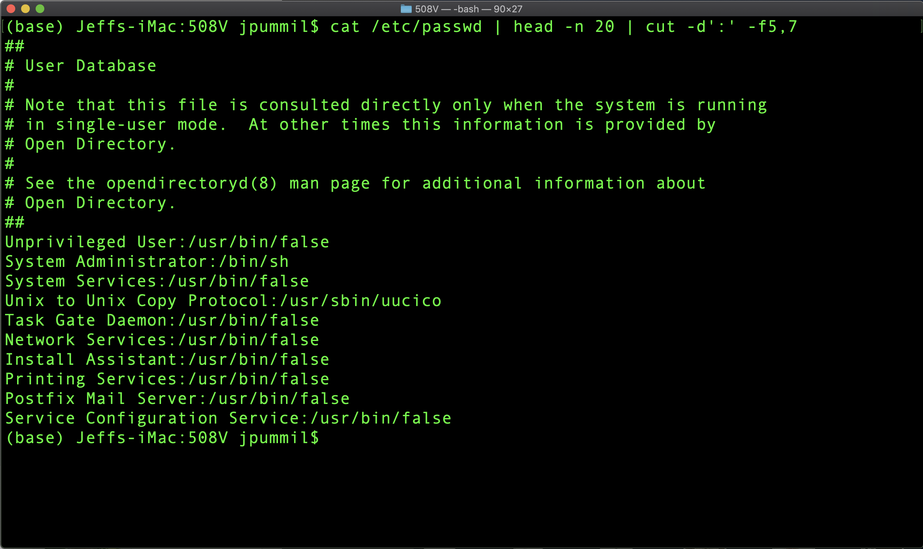
Scientific Computing for Biologists

Slide 14
Scientific Computing for Biologists
So, let’s get right to it! Some new basic commands to incorporate:
cat – concatenate files to standard output
cut – remove sections from each line of files
sort – sort lines of text files
diff – compare files line by line
uniq – report or omit repeated lines
BONUS COMMAND: clear – clears the messy text in the terminal
BONUS COMMAND: history – log of previous commands executed
BONUS COMMAND: Tab and Arrow-Up – short cut keys
BONUS COMMAND: Man <command> - help file for linux commands

Slide 15
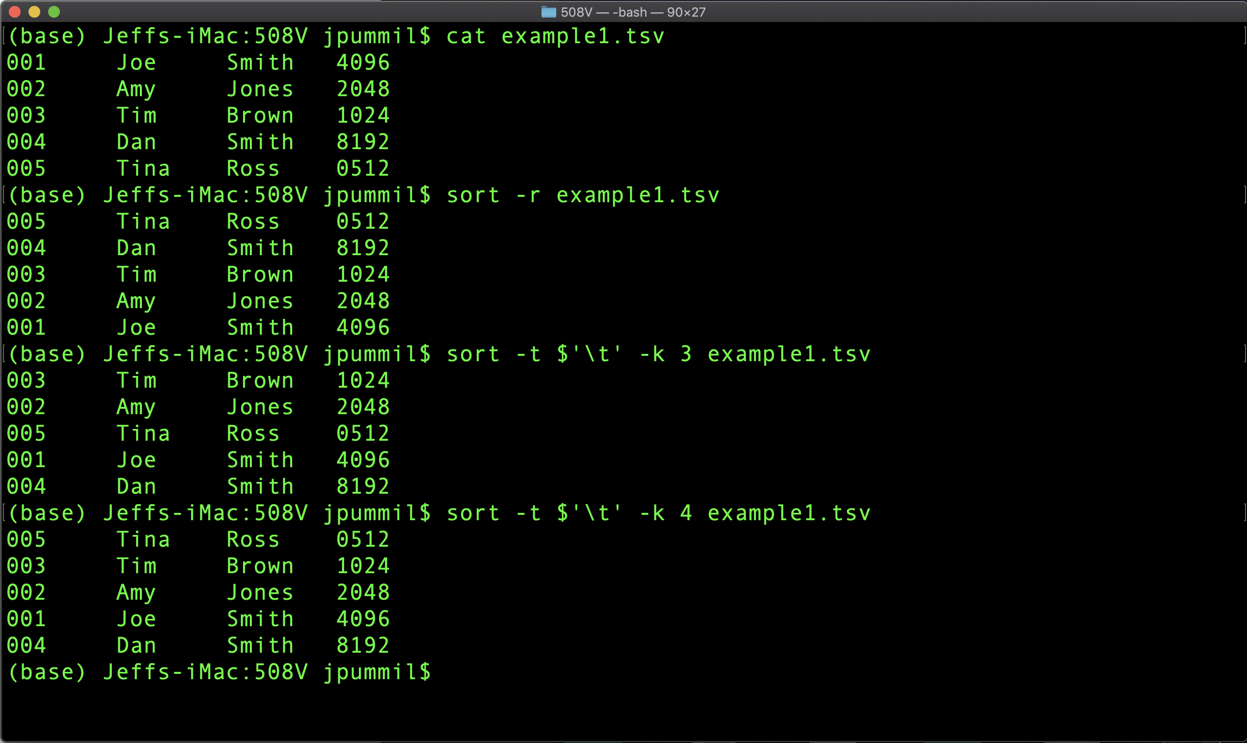
Scientific Computing for Biologists

Slide 16
Scientific Computing for Biologists
So, let’s get right to it! Some new basic commands to incorporate:
cat – concatenate files to standard output
cut – remove sections from each line of files
sort – sort lines of text files
diff – compare files line by line
uniq – report or omit repeated lines
BONUS COMMAND: clear – clears the messy text in the terminal
BONUS COMMAND: history – log of previous commands executed
BONUS COMMAND: Tab and Arrow-Up – short cut keys
BONUS COMMAND: Man <command> - help file for linux commands

Slide 17
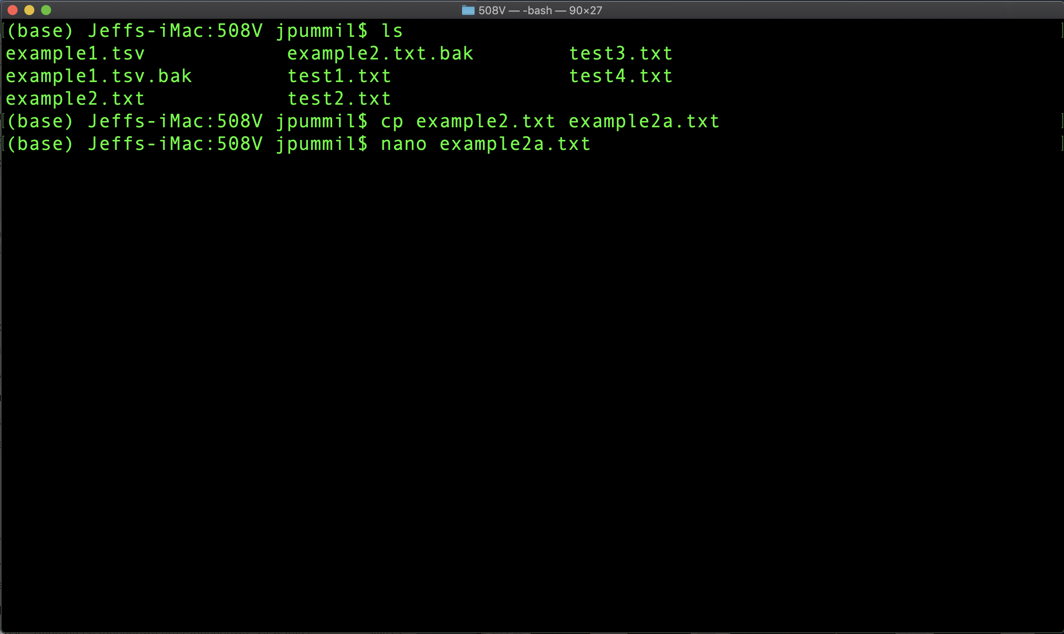
Scientific Computing for Biologists

Slide 18
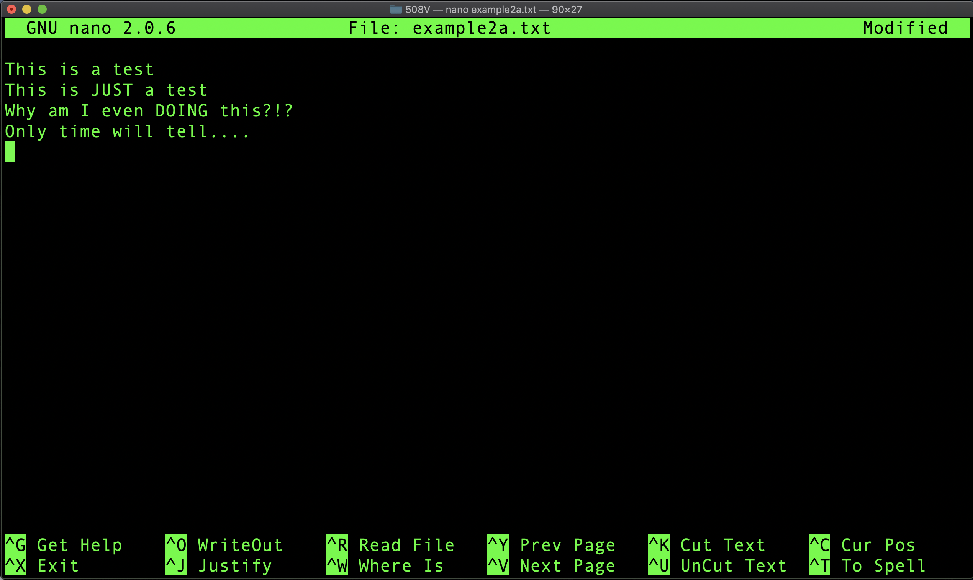
Scientific Computing for Biologists

Slide 19
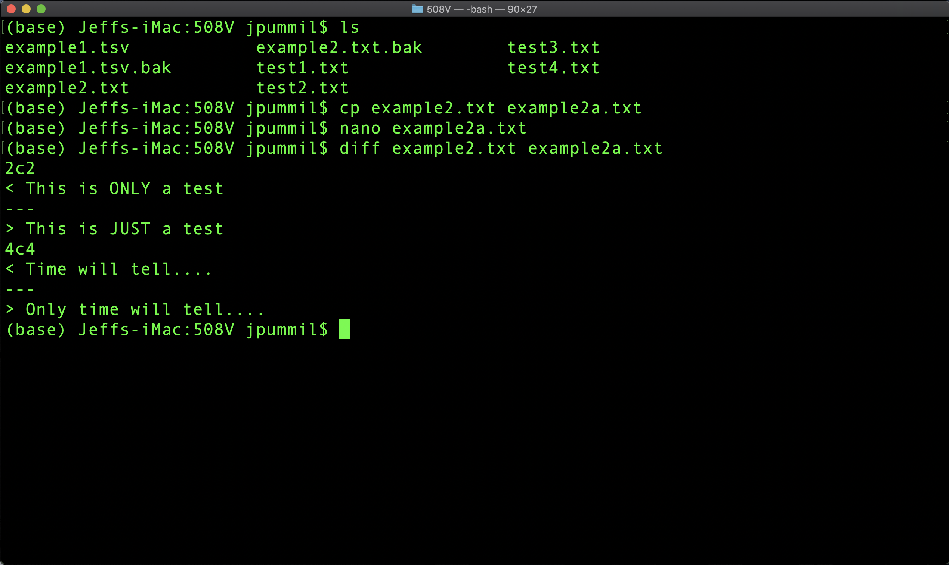
Scientific Computing for Biologists

Slide 20
Scientific Computing for Biologists
Half time!
5-10 minute break…

Slide 21
Scientific Computing for Biologists
So, let’s get right to it! Some new basic commands to incorporate:
cat – concatenate files to standard output
cut – remove sections from each line of files
sort – sort lines of text files
diff – compare files line by line
uniq – report or omit repeated lines
BONUS COMMAND: clear – clears the messy text in the terminal
BONUS COMMAND: history – log of previous commands executed
BONUS COMMAND: Tab and Arrow-Up – short cut keys
BONUS COMMAND: Man <command> - help file for linux commands

Slide 22
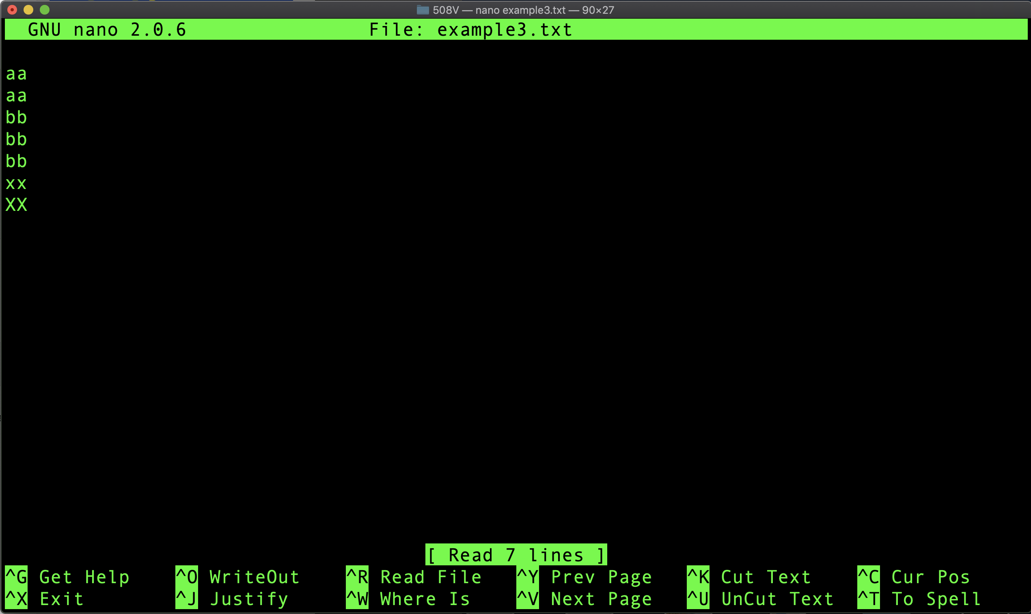
Scientific Computing for Biologists

Slide 23
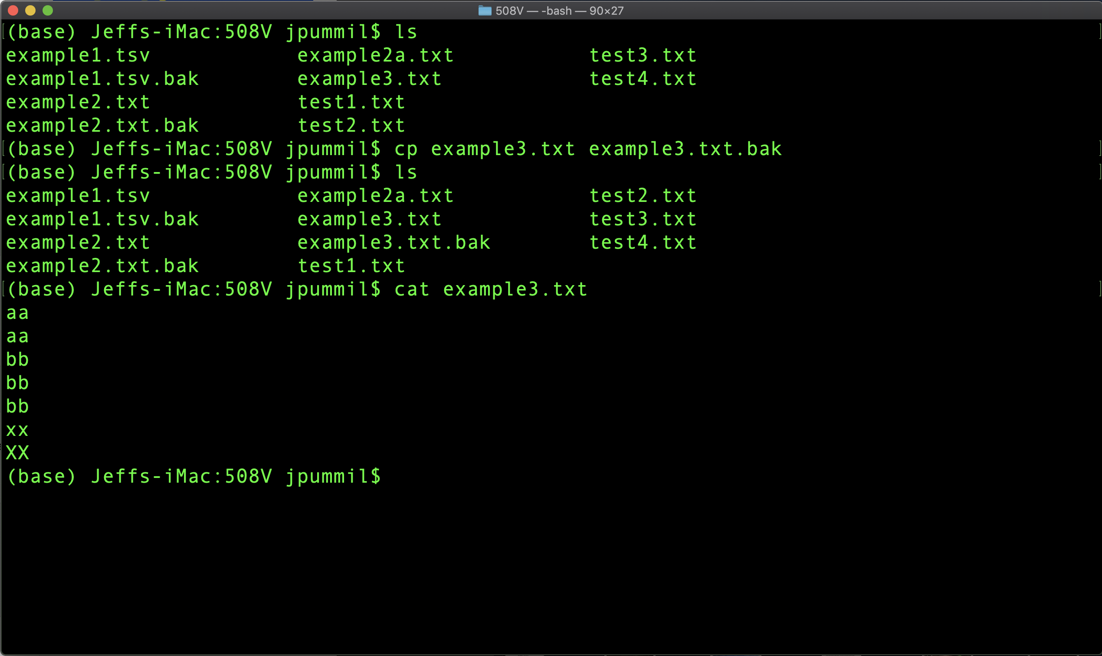
Scientific Computing for Biologists

Slide 24
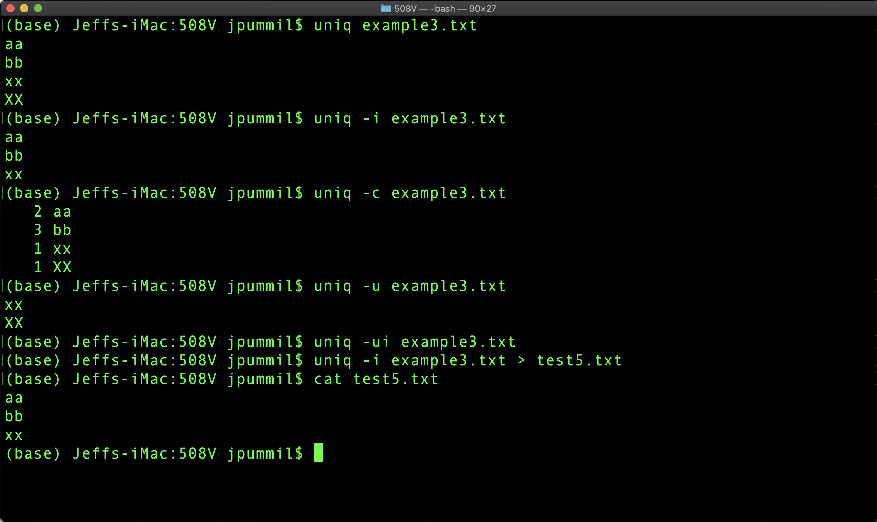
Scientific Computing for Biologists

Slide 25
Scientific Computing for Biologists
For the rest of this class session, experiment with:
Using the commands you have learned this week with their various flags, think about and experiment with your own unique combinations to manipulate larger example files that you create with nano.
Use the two web url’s on the next slide for advanced help, tips, explanations, etc.

Slide 26
Scientific Computing for Biologists
Great web site for TONS of examples:
https://www.thegeekstuff.com/
https://explainshell.com/

Slide 27
Scientific Computing for Biologists
Jeff Pummill
Director – Strategic Initiatives & User Services
Arkansas High Performance Computing Center
Adjunct Graduate Faculty – Biological Sciences
University of Arkansas – JBHT 410
jpummil@uark.edu
@jpummil on Twitter

